Slide 1


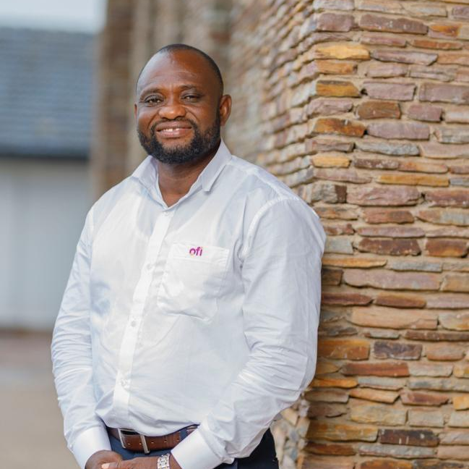
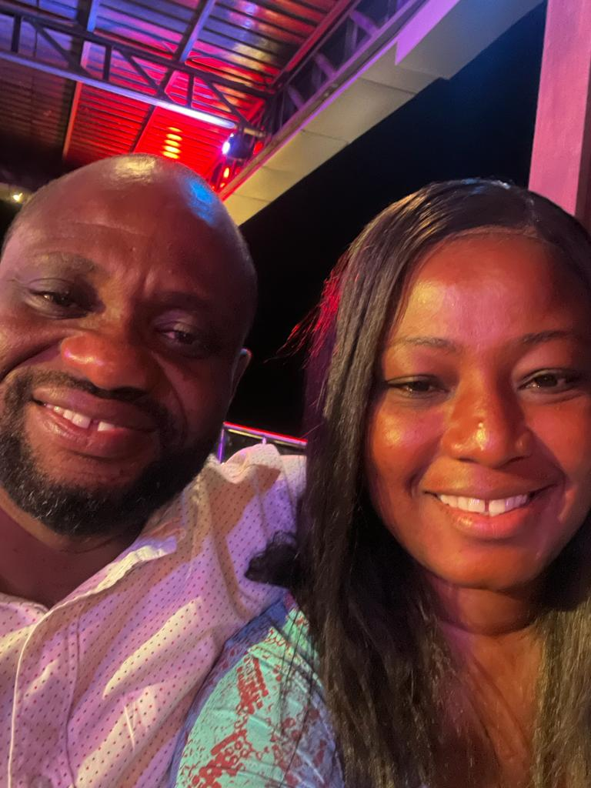
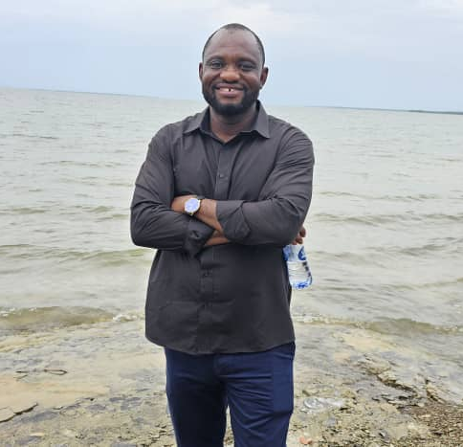
Getting to Know Me
Work
Personal
My role
Deputy procurement Head-LBC
Significant others / family members / furry friends in my life
Text Nuclear family(Patience, Davis, Sam and Awo) & and a part of an extended and Plau Royal family. Friends: Ben ,George and Patrick
Tenure in ofi/Olam
23 years
How I enjoy spending my free time
Text Love to go to church, meditate but will always locate family, home & natural places
Previous companies I have worked at
Eddie-Kay Venture (Import & Exports, Benin,) 1 year
My favorite / comfort food
Text Any kind of rice, light soup, plantain chips
Why I joined ofi/Olam and what keeps me here?
opportunity to learn and develop my career, be responsible and make friends.
My favorite song
Text Hip –Hop and Highlife songs
First name Last name
Wisdom Nyumuyo
‘what name you prefer to be called’
A few fun facts about me
As the youngest brother among my siblings , I still demand money from my elder brothers and ask they take care of me citing custom
This is me outside work, doing stuff I enjoy in my life …

